Slide 1
Que. What are the tools used by a tester while testing?
Selenium
Firebug : Firebug mainly allows its users to debug, edit and monitor of any website’s CSS, HTML, DOM and JavaScript. It also features a Java Script console for logging errors and watching values, as well as a “Net” feature which monitors the amount of time in milliseconds it takes to execute scripts and load images on the page.

Slide 2
OpenSTA : Open System Testing Architecture - a distributed software testing architecture designed around CORBA.
WinSCP: WinSCP is an open source free SFTP client, SCP client, FTPS client and FTP client for Windows. Its main function is file transfer between a local and a remote computer.

Slide 3
YSlow for FireBug : YSlow analyzes web pages and suggests ways to improve their performance based on a set of rules
Web Developer toolbar for firefox :

Slide 4
Programming techniques.
Good programming techniques :
• Top-down design for complex problems
• Sequence, selection and iteration constructs
• Keeping local variables within procedures
• Proper use of parameter passing
• Meaningful variable and procedure names
• Proper documentation

Slide 5
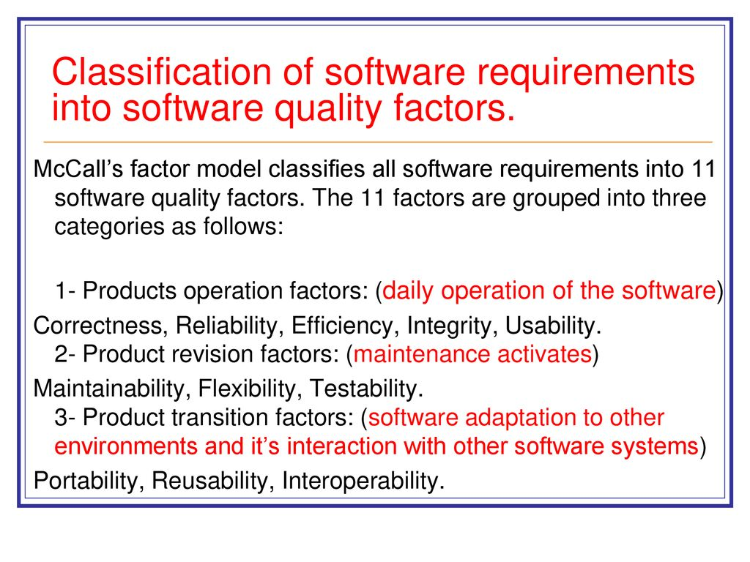

Slide 6
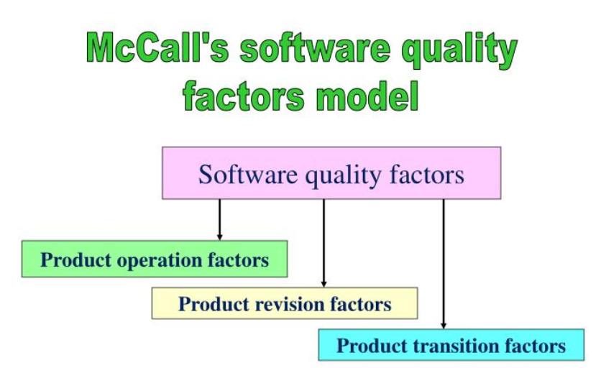
Classification of software requirements into s/w Quality factors

Slide 7
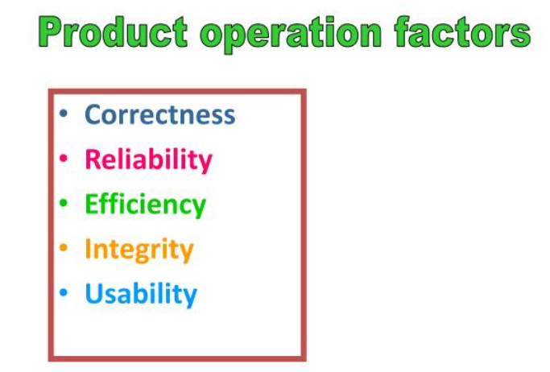
Degree to which:
Fault free
Intended function with required precision
Keeping to its capacity
Controlling unauthorized access
Output interpretation

Slide 8
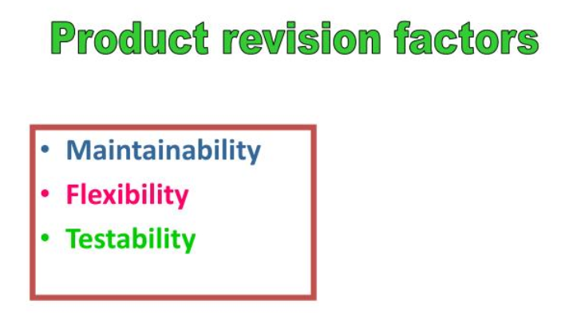
With evolution allowing to:
Fix the error
Transform w.r.t Change
Deliver as per planned capacity

Slide 9
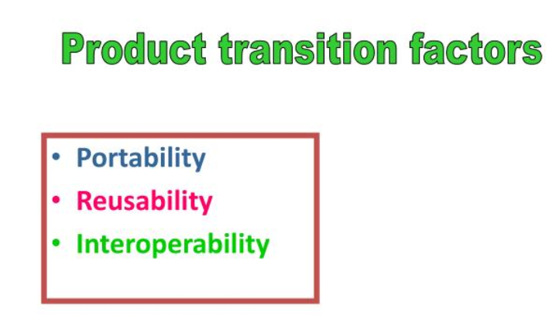
Capacity in alternate domain:
To adapt to different configuration
To be compatible with another app.
To interface with another system

Slide 10
The mean time between failures - under pre-defined conditions, the average time between consecutive failures over a given period in the life of a system.
The mean time to repair - the average time to repair or maintain equipment.

Slide 11
The mean time to recover - the average time to return a system to operation after a failure. The time involved should include periods taken to re-instate from previous checkpoints.
The probability of failure - the use of formal methods to predict the likelihood that a system will behave in an expected way under certain circumstances.

Slide 12
Consider the following testing scenario:
Code coverage
2. Segment coverage: Ensure that each code statement is executed once.
3. Branch Coverage or Node Testing: Coverage of each code branch in from all possible ways.
4. Compound Condition Coverage: For multiple conditions test each condition with multiple paths

Slide 13
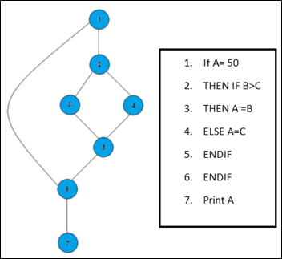
5. Basis Path Testing: Each independent path in the code is taken for testing.

Slide 14
6. Data Flow Testing (DFT):
Data Flow Testing uses the control flow graph to find the situations that can interrupt the flow of the program.
Reference or define anomalies in the flow of the data are detected at the time of associations between values and variables.
These anomalies are:
A variable is defined but not used or referenced,
A variable is used but never defined,
A variable is defined twice before it is used

Slide 15
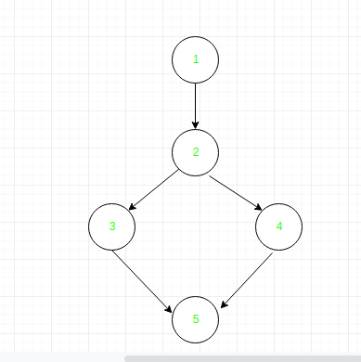
Example:
read x, y;
if(x>y)
a = x+1 else
a = y-1
print a;
Control flow graph of above eg:

Slide 16
Define/use of variables of above example:
VARIABLE | DEFINED AT NODE | USED AT NODE
x | 1 | 2, 3
y | 1 | 2, 4
a | 3, 4 | 5

Slide 17
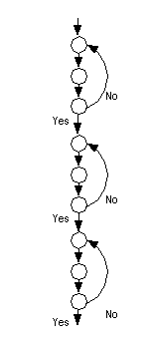
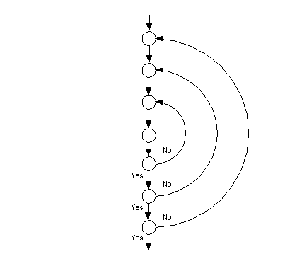
7. Loop Testing:
These strategies relate to testing single loops, concatenated loops, and nested loops.

Slide 18
Statement coverage : involves the execution of all the statements at least once in the source code. It is a metric, which is used to calculate and measure the number of statements in the source code which have been executed.

Slide 19
INPUT A & B
C = A + B
IF C>100
PRINT “ITS DONE”
For Statement Coverage – we would only need one test case to check all the lines of the code.
That means:
If I consider TestCase_01 to be (A=40 and B=70), then all the lines of code will be executed.

Slide 20
For maximum coverage, we need to consider “Branch Coverage”, which will evaluate the “FALSE” conditions.
So now the pseudocode becomes:
INPUT A & B
C = A + B
IF C>100 PRINT “ITS DONE”
ELSE
PRINT “ITS PENDING”

Slide 21
Path coverage : is used to test the complex code , which basically involve loop statements or combination of loops and decision statements.
INPUT A & B
C = A + B
IF C>100
PRINT “ITS DONE”
END IF
IF A>50
PRINT “ITS PENDING”
END IF

Slide 22
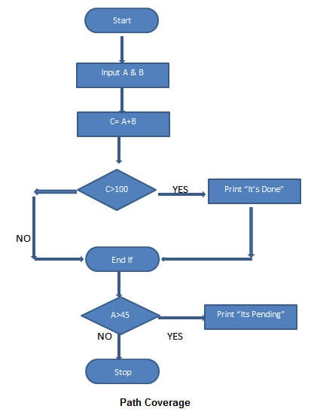
Now to ensure maximum coverage, we would require 4 test cases.
How?
Simply – there are 2 decision statements, so for each decision statement, we would need two branches to test.

Slide 23
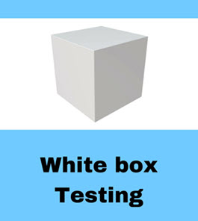
STEP 1) UNDERSTAND THE SOURCE CODE
Step 2) CREATE TEST CASES AND EXECUTE

Slide 24
WhiteBox Testing Example
Consider the following piece of code
Printme (int a, int b)
{ ------------ Printme is a function
int result = a+ b;
If (result> 0)
Print ("Positive", result)
Else
Print ("Negative", result)
} ----------- End of the source code

Slide 25
The goal of WhiteBox testing in software engineering is to verify all the
Decision branches,
Loops,
Statements in the code.
To exercise the statements in the above code, WhiteBox test cases would be:
A = 1, B = 1
A = -1, B = -3 B

Slide 26
Following are important White-Box Testing Techniques:
Statement Coverage
Decision Coverage
Branch Coverage
Condition Coverage
Multiple Condition Coverage
Finite State Machine Coverage
Path Coverage
Control flow testing
Data flow testing

Slide 27
A FSM is defined by its states,
its initial state and the transitions.
State Diagram
There are three possible states for the coffee machine:
Open
ReadyToBuy
PoweredOff
The lines between these states show which transitions are possible between states and in which direction.
These transitions have conditions for when the FSM needs to change between states.

Slide 28
White Box Testing Tools
Below is a list of top white box testing tools.
Parasoft Jtest
EclEmma
Nunit
PyUnit
HTMLUnit
CppUnit

Slide 29
Advantages of White Box Testing
Code optimization by finding hidden errors.
White box tests cases can be easily automated.
Testing is more thorough as all code paths are usually covered.
Testing can start early in SDLC even if GUI is not available.

Slide 30
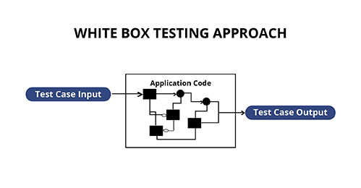

Slide 31
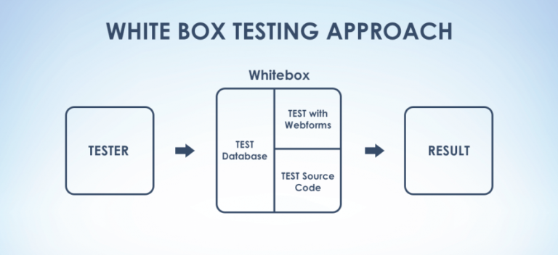

Slide 32
The following parameters are verified in white box testing:
Output and input flow
Security elements
Usability
Design
The white box is largely based on checking the internal functionality of the application.

Slide 33
Examination Question:
Que. 1) Discuss the important functionalities of White box testing techniques and elaborate their test scenarios.
Que. 2) Explain various techniques of White box testing .
Que. 3) Write the advantages, disadvantages and various tools employed in this testing technique.

Slide 34
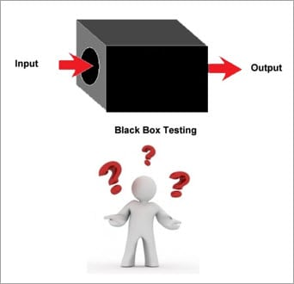

Slide 35
It is a Software Testing method that analyses the functionality of a software/application without knowing much about the internal structure/design of the application that is being tested and compares the input value with the output value.

Slide 36
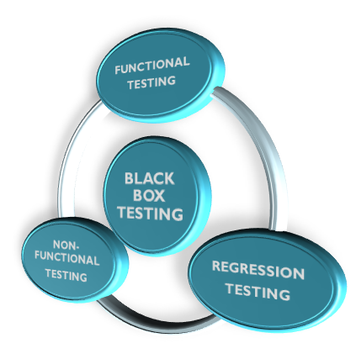
This testing occurs throughout the software development and Testing Life Cycle i.e in
Unit,
Integration,
System,
Acceptance, and
Regression Testing stages.
This can be both Functional or Non-Functional.

Slide 37
For Example, when we test a Dropdown list, we click on it and verify that it expands and all the expected values are showing in the list.
This is the case of Functional aspect.
Functional Testing are:
Smoke Testing
Sanity Testing
Integration Testing
System Testing
Regression Testing
User Acceptance Testing

Slide 38
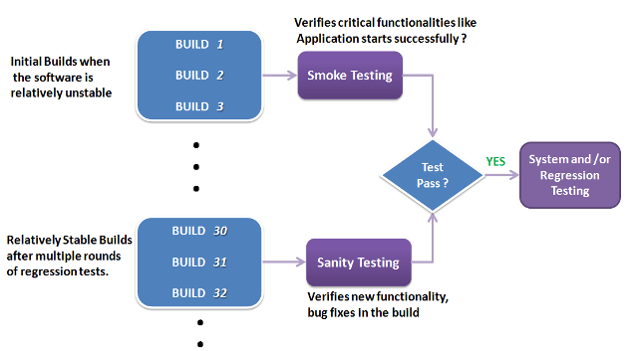

Slide 39
Smoke testing is a subset of acceptance testing whereas Sanity testing is a subset of Regression Testing.
Smoke testing verifies the entire system from end to end whereas Sanity Testing verifies only a particular component.
For instance, if your scientific calculator gives the result of 2 + 2 =5! Then, there is no point testing the advanced functionalities like sin 30 + cos 50.

Slide 40
Consider an Eg.
when you made an application and it goes live, it might result in critical or major issues like :
when the load is increased on the application, it becomes too slow and takes a lot of time to open.
Response time might increase or when the load is increased to an extent, the application might crash.

Slide 41
Non-Functional Testing include:
Usability Testing
Load Testing
Performance Testing
Compatibility Testing
Stress Testing
Scalability Testing 9th July A Div

Slide 42
Black Box Testing Tools :
Black Box Testing tools are mainly record and playback tools. These tools are used for Regression Testing to check whether new build has created any bug in previous working application functionality.
These record and playback tools record test cases in the form of some scripts like VB script, Javascript, Perl, etc.

Slide 43
Black Box Testing Techniques :
In order to systematically test a set of functions, it is necessary to design test cases.
Testers can create test cases from the requirement specification document using the following Black Box Testing techniques.

Slide 44
Equivalence Partitioning
Boundary Value Analysis
Decision Table Testing
State Transition Testing
Error Guessing
Graph-Based Testing Methods
Comparison Testing

Slide 45
#1) Equivalence Partitioning
In this technique, input values to the application are divided into different classes or groups based on its similarity in the outcome.
Hence, instead of using each and every input value we can now use any one value from the group/class to test the outcome.

Slide 46
Equivalence class Partitioning
Attendance : |  | Enter Value | * Accept values between 0 to 100
EQUIVALENCE CLASS PARTITIONING
DEBARRED IN EXAM |  |  | ALLOWED TO APPEAR IN EXAM
< 40 |  |  | 40-100
Thus reducing the test cases to only 2 test cases based on the formed classes thereby covering all the possibilities. So, testing with any one value from each set of the class is sufficient to test the scenario.
Div A 11th July

Slide 47
#2) Boundary Value Analysis
In this technique we focus on the values at boundaries as it is found that many applications have an issues on the boundaries.
Boundary means the values near the limit where the behavior of the system changes.
In boundary value analysis both the valid inputs and invalid inputs are being tested to verify the issues.

Slide 48
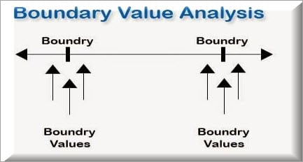
If we want to test a field where values from 1 to 100 should be accepted then we choose the boundary values:
0, 1, 2, 99, 100, and 101.

Slide 49
#3) Decision Table Testing
wherever there are logical relationships like:
If { (Condition = True) then action1 ; } else action2; /*(condition = False)*/
Then a tester will identify two outputs (action1 and action2) for two conditions (True and False). So based on the probable scenarios a Decision table is made to prepare a set of test cases.

Slide 50
A decision table’s property of dealing with large number of combinations of input with varied responses is useful in the field of software testing.
Input condition | Value 1 | Value 2 | Value 3
TRAINS FROM | F | T | T
TRAINS TO | T | F | T
Booking activated | F | F | T

Slide 51
#4) State Transition Testing
State Transition Testing is a technique that is used to test the different states of the system under test.
The state of the system changes depending upon the conditions or events.
The events trigger states which become scenarios and a tester needs to test them.

Slide 52
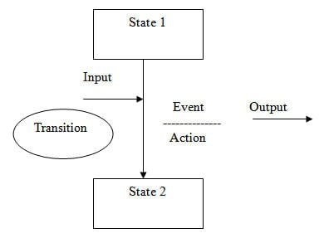
To explain it with an example:
You visit an ATM and withdraw Rs. 1000. You get your cash. Now you run out of balance and make exactly the same request of withdrawing Rs.1000.
This time ATM refuses to give you the money because of insufficient balance. So, here the transition, which caused the change in state is the earlier withdrawal

Slide 53
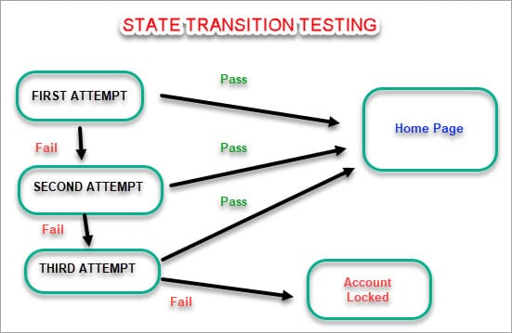

Slide 54
State Transition testing can be implemented in the following situations:
When the application under test is a real-time system with different states and transitions encompassed.
When the application is dependent upon the event/values/conditions of the past.
When the sequence of events needs to be tested.
When the application needs to be tested against a finite set of input values.

Slide 55
Test Case
Start State
Input
Output
Finish state
Identify the initial states and their final state.
For each initial state, find out the input condition and the output result
Mark each set as a separate test case.
Eg: From Student state to student state

Slide 56
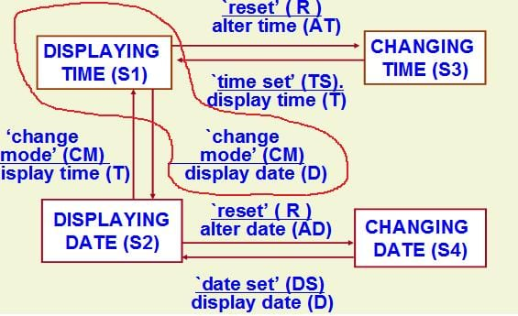


Slide 57
 | Update SGPA ---->
Current Grade status |  |  |  |  | Final Grade status
 | <------Alter CGPA
Programming area
Update Knowledge
 | Posting domain ------>
Technology Domain |  |  |  |  | Training
 | <-------Skill Enhancement

Slide 58
Advantages of State Transition testing
In this technique, by using a pictorial or tabular representation of system behavior, the tester becomes familiar with the application design and covers the design the tests effectively and efficiently.
The unplanned or invalid states of the system get also covered by using this technique.
Using the State Transition diagram, it's easy to verify if all the conditions are covered.

Slide 59
During functional testing, the tester checks only the __________________ of the software and will not check the actual code.
Static testing is performed to check the bugs in the software using the ____________ of the respective software.

Slide 60
(c) ______________ testing is also called as glass box testing.
(d) Developing efficient______________ are very essential during testing.

Slide 61
Disadvantages of State Transition testing:
This technique can’t be used for nonfinite state systems.
Defining all possible states for large and complex systems is tedious and may not be possible all the times.

Slide 62
Remark :
State Transition testing is a helpful approach when different system transitions are required to be tested for finite-state systems.

Slide 63
When not to use State Transition Testing?
Under the following situations:
When testing is not required for sequential input combinations. Eg ……………………………….
When different functionalities of the application are required to be tested (more like Exploratory testing).

Slide 64
#5) Error Guessing:
An example of Experience-Based Testing.
In this technique, the tester can use experience about the application behavior and functionalities to guess the error-prone areas.

Slide 65
Few common mistakes that developers usually forget to handle:
Divide by zero.
Handling null values in text fields.
Accepting the Submit button without any value.
File upload without attachment.
File upload with less than or more than the limit size.

Slide 66
#6) Graph-Based Testing Methods
Each and every application is a build-up of some objects. All such objects are identified and the graph is prepared. From this object graph, each object relationship is identified and test cases are written accordingly to discover the errors.

Slide 67
Graph Based Testing :
i. It provides a framework for model based testing.
ii. Black-box methods based on the nature of the relationships (links) among the program objects (nodes), test cases are designed to traverse the entire graph.

Slide 68
iii. Transaction flow testing –
Nodes represent steps in transaction and links represent logical connections between steps that need to be validated.
iv. Finite state modeling – Nodes represent user observable states of the software and links represent transitions between states.

Slide 69
v. Data flow modeling –
nodes are data objects and links are transformations from one data object to another.
vi. Timing modeling –
nodes are program objects and links are sequential connections between these objects, link weights are required during execution times.

Slide 70
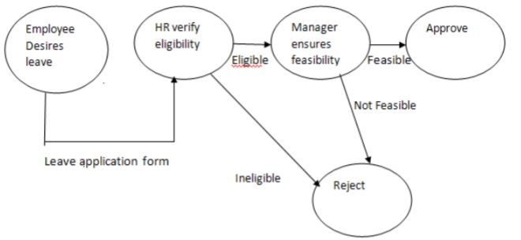
Test data is derived so that test paths can be executed.
Example: Leave Application

Slide 71
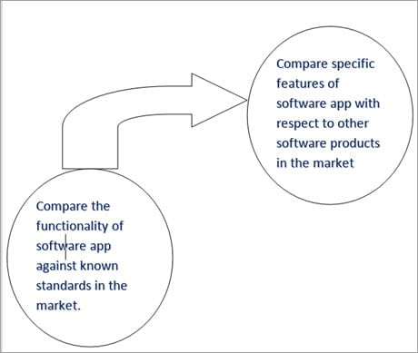
#7) Comparison Testing
Different independent versions of the same software are used to compare to each other for testing in this method.

Slide 72
What kind of comparison we do , depends on the object of testing. For example, the object of testing could be:
A web application
ERP application
CRM application
A module of an application requiring validation of data after completion of a transaction

Slide 73
For Example, the following features can be considered for comparison with other software products.
#1) Price
#2) Performance of application
Example: Response time, network load
#3) User Interface (look and feel, ease of use)

Slide 74
Given below is a java statement code. Write test cases that bring
out the mistakes of the code:
class TestProg {
public static void main(String[ ] args)
{
int mark = 76;
char grade;
if (mark >= 90) {
grade = 'A';
} else if (mark >= 80) {
grade = 'B';
} else if (mark >= 70) {
grade = 'C';
} else if (mark >= 60) {
grade = 'D';
} else {
grade = 'F';
}
System.out.println("Your Grade is:" + grade);
}
}

Slide 75
Examination Questions on this topic:
Q.1) Which are the seven techniques applied during Black box testing
implementation.
Q.2) Compare Equivalence class testing with Boundary value testing
methodology.
Q.3) Differentiate between State transition testing & Decision table
testing techniques.
Q.4) Explain through example Comparison testing .

Slide 76
Q.5 )What is graph based testing and where it is used.
Q.6) Explain the important features of Black box testing techniques. And write its advantages & disadvantages.
Q.7 )Compare Black box methodology with White box techniques.
****************************************

Slide 77
Black Box Testing Disadvantages :
Every object or process, impacts efficiency as well as working of the model.
So, there are few drawbacks attached to black box testing, which hinder thorough testing of the software and prohibit it from working exponentially.
____________________________________________
Working with a huge Sample space of test inputs can be exhaustive and put a drain on time.

Slide 78
It tests only a small portion of the software, as testing the software thoroughly can be time consuming.
Tests in black-box testing can be termed redundant if they are already executed by the software developer or designer.

Slide 79
Results offered by black box testing can often be overestimated.
It cannot be used for testing complex codes and softwares.

Slide 80
Besides, the probability of meeting dead ends in an unspecified path during testing is pretty high.
Because of black box testing dependency on specifications, it is difficult to design test cases without well defined, precise, as well as concise specifications.

